Slide 1

NESD Preliminary Health & Safety Reopening Plans
2020-2021 School Year
Dr. Michele S. Hartzell, Superintendent
Dr. Steven Karns, Principal NEMS
June 25, 2020

Slide 2
ERIE COUNTY COVID-19 STATISTICS
Total cases (as of 6/17): 478
  152 active cases
  317 recovered cases
  7 deaths
  10% of all cases are children ages 0-18 years old
10 confirmed cases in 16428 zip code
                Emily Shears, UPMC
                Erie County DOH Data

Slide 3
NESD PARENT SURVEY

Slide 4

Who responded?
602 responses
991 students
60% of the students in the district

Slide 5
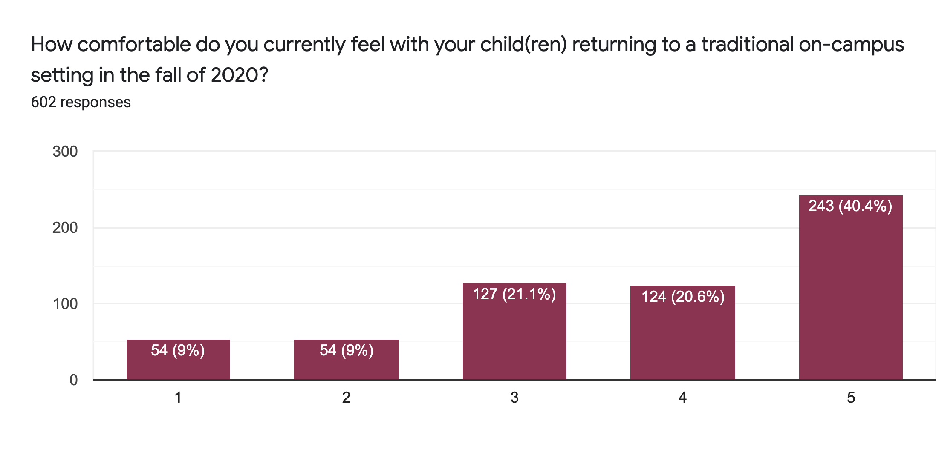
Not comfortable
Very comfortable
82.1% Somewhat to very Comfortable

Slide 6
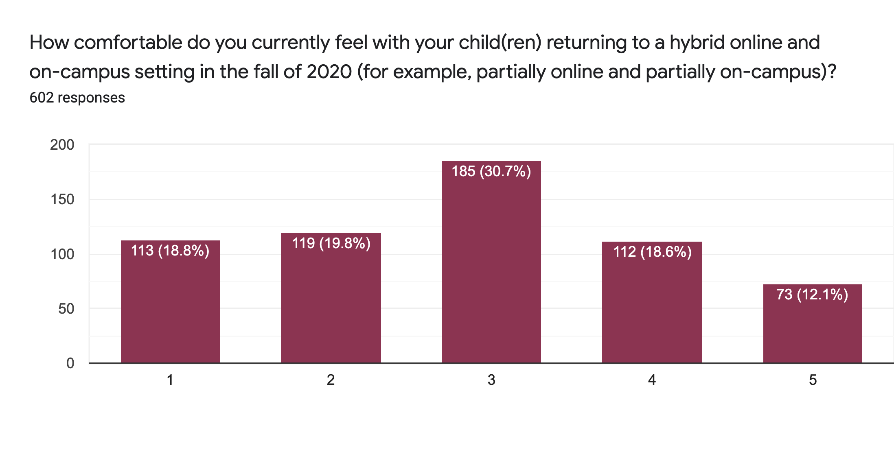
Not comfortable
Very comfortable

Slide 7
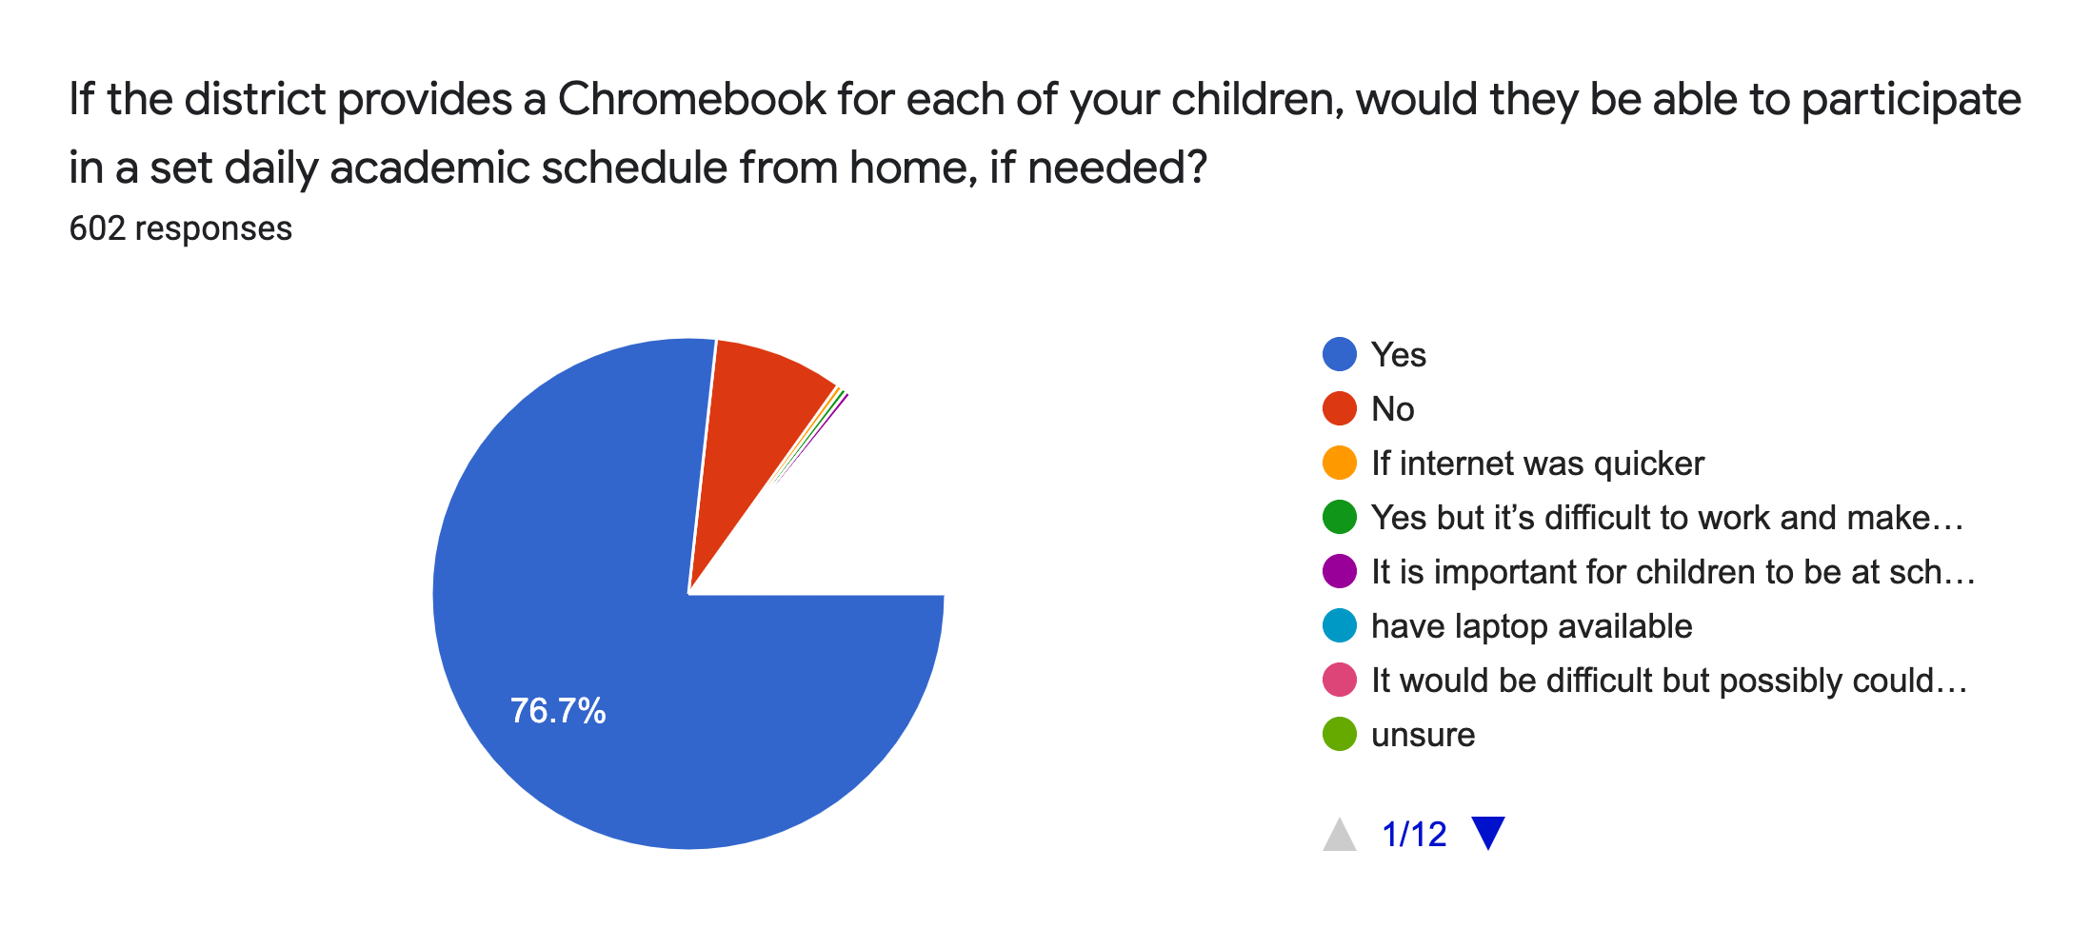
No (8.1%)
Other
Yes

Slide 8
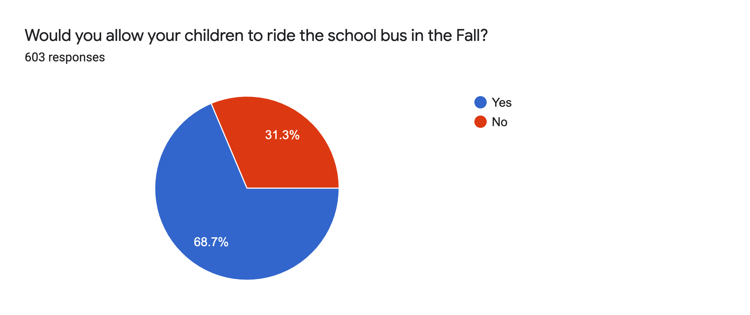

Slide 9
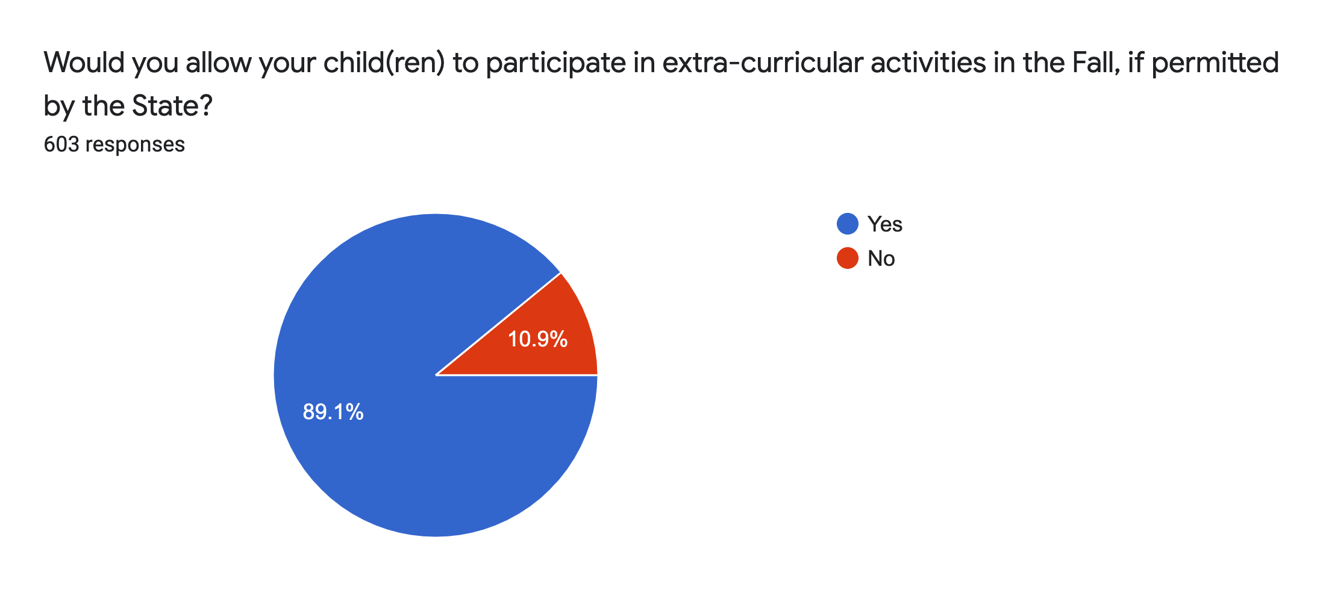

Slide 10
Pennsylvania Department of Education Requirement
The documents are guidelines for instructional and non-instructional reopening activities
The Red Phase: Schools remain closed for in-person instruction and all instruction must be provided via remote learning, whether using digital or non-digital platforms.
Include provisions for student services such as school meal programs
The Yellow Phase and Green Phase: Schools may provide in-person instruction

Slide 11
Pandemic Team
Administration
Parents
Teachers - Special Education Teachers
Transportation, Maintenance, Food Service, and Technology Supervisors
Counselors
Nurses
Support Staff/Aides

Slide 12
Number one goal is the safety of our students and staff

Slide 13
Enhanced Cleaning
Hand sanitizer will be available in each room
Teachers will be provided with disposable wipes and spray cleaner to use throughout the day
Frequent touchpoints (door handles, sinks, etc.) will be cleaned at least twice per day
Safe, effective cleaning products will be used in all student spaces and on buses every day
Intense nightly cleaning

Slide 14
Daily Health Screenings
Students & staff who are not feeling or who have an elevated temperature must stay home
Parents will be asked to self monitor symptoms prior to children coming to school or getting on the bus
All student and staff will have their temperature taken when they arrive at school
Anyone with a temperature above 100.4 degrees will be sent to the nurse, who will conduct a secondary temperature reading and evaluate the individual

Slide 15
Desks will be spaced as far apart as possible in class
Classrooms will be decluttered to provide maximum space
Utilization of all classrooms and auxiliary spaces
Seating charts will be required on buses and in classrooms
Transitions will be limited throughout the school day
Common areas will be limited
We will use disposable trays for lunch
Capacity will be limited in the middle and high school cafeterias
Elementary students will eat their classrooms

Slide 16
Posters will be hung throughout each building emphasizing good hygiene practices
Student and staff will be encouraged to wash hands frequently (before and after eating, when changing rooms, etc.) and not share school supplies
Students should not share materials
Students should have their own water bottle
We will provide individual resources for students in K-5
Parent pick-up at the Elementary Center will change
Parents will stay in cars, similar to parent drop-off

Slide 17
Face Masks/Shields
Students and staff will be required to wear a mask when they enter or exit the buildings
When they are in common spaces and when they are unable to maintain social distance from others (example – working one on one with student/Students as lab partners
They will not be required to a wear a mask when they are at their seat in class
Masks will be required when riding the bus

Slide 18
Only essential personnel providing service to our students will be permitted in the buildings
Bus transportation is currently limited to two per seat, 3 with family members
Cleaning of buses will be done between runs
We will not provide bus passes except for custodial care
The district will follow the CDC guidelines for COVID-19 including local Department of Health contract tracing protocols

Slide 19
Athletics/Activities
The NESD will take the necessary precautions and recommendations from the federal, state, and local governments, CDC, PA DOH, as well as the NFHS and PIAA.
The NESD realizes the knowledge regarding COVID-19 is constantly changing as new information and treatments become available. These recommendations will be adjusted as needed as new information becomes available in order to decrease the risk of exposure for our staff, students, and spectators.

Slide 21
Teachers and staff will receive professional development on:
Symptoms and screening measures for COVID-19
Managing Stress through COVID
Proper Wearing of Masks
Teaching in a virtual platform
Google Classroom

Slide 22
What we are working on:
Send out parent update letter – June 26, 2020
Finalize learning options for the Fall of 2020
Continue to meet with Task Force to finalize learning options
Set up virtual student and parent forums
Conduct a second survey for parents on learning options
Plan for teacher in-service
Work on set schedule for online learning for consistency
Develop expectations and guidelines for online learning for students, parents and teachers
Continue to reflect and make adjustments as needed
.

